Slide 1
Chapter 14
IT Security Management
and Risk Assessment
Notes:
In previous chapters, we discussed a range of technical and administrative measures that
can be used to manage and improve the security of computer systems and networks. In
this chapter and the next, we look at the process of how to best select and implement
these measures to effectively address an organization’s security requirements. As we
noted in Chapter 1, this involves examining three fundamental questions:
1. What assets do we need to protect?
2. How are those assets threatened?
3. What can we do to counter those threats?

Slide 2
IT Security Management Overview
What assets need to be protected
How are those assets threatened
What can be done to counter those threats
Is the formal process of answering the questions:
Ensures that critical assets are sufficiently protected in a cost-effective manner
Security risk assessment is needed for each asset in the organization that requires protection
Provides the information necessary to decide what management, operational, and technical controls are needed to reduce the risks identified
Notes:
IT security management is the formal process of answering these questions, ensuring
that critical assets are sufficiently protected in a cost-effective manner. More specifically,
IT security management consists of first determining a clear view of an organization’s IT
security objectives and general risk profile. Next, an IT security risk assessment is needed
for each asset in the organization that requires protection; this assessment must answer
the three key questions listed above. It provides the information necessary to decide
what management, operational, and technical controls are needed to either reduce
the risks identified to an acceptable level or otherwise accept the resultant risk. This
chapter will consider each of these items. The process continues by selecting suitable
controls and then writing plans and procedures to ensure these necessary controls
are implemented effectively. That implementation must be monitored to determine if
the security objectives are met. The whole process must be iterated, and the plans and
procedures kept up-to-date, because of the rapid rate of change in both the technology
and the risk environment. We discuss the latter part of this process in Chapter 15. The
following chapters, then, address specific control areas relating to physical security in
Chapter 16, human factors in Chapter 17, and auditing in Chapter 18.

Slide 3
Table 14.1
ISO/IEC 27000 Series of Standards on IT Security Techniques
Notes:
The discipline of IT security management has evolved considerably over the last few
decades. This has occurred in response to the rapid growth of, and dependence on, networked
computer systems and the associated rise in risks to these systems. In the last
decade a number of national and international standards have been published. These
represent a consensus on the best practice in the field. The International Standards
Organization (ISO) has revised and consolidated a number of these standards
into the ISO 27000 series. Table 14.1 details a number of recently adopted
standards within this family. In the United States, NIST has also produced a number
of relevant standards, including NIST SP 800-18 (Guide for Developing Security
Plans for Federal Information Systems, February 2006), NIST SP 800-30 (Guide
for Conducting Risk Assessments, September 2012), and NIST SP 800-53 (Security
and Privacy Controls for Federal Information Systems and Organizations, January
2015). NIST also released the “Framework for Improving Critical Infrastructure
Cybersecurity ”in 2014, to provide guidance to organizations on systematically managing
cybersecurity risks. With the growth of concerns about corporate governance
following events such as the global financial crisis and repeated incidences of the
loss of personal information by government organizations and other businesses,
auditors for such organizations increasingly require adherence to formal standards
such as these.

Slide 4
IT Security Management
IT SECURITY MANAGEMENT: A process used to achieve and maintain appropriate levels of confidentiality, integrity, availability, accountability, authenticity, and reliability. IT security management functions include:
Determining organizational IT security objectives, strategies, and policies
Determining organizational IT security requirements
Identifying and analyzing security threats to IT assets within the organization
Identifying and analyzing risks
Specifying appropriate safeguards
Monitoring the implementation and operation of safeguards that are necessary in order to cost effectively protect the information and services within the organization
Developing and implementing a security awareness program
Detecting and reacting to incidents
Notes:
[ISO13335] provides a conceptual framework for managing security. It defines
IT security management as follows:
IT SECURITY MANAGEMENT: A process used to achieve and maintain appropriate
levels of confidentiality, integrity, availability, accountability, authenticity, and reliability.
IT security management functions include:
• determining organizational IT security objectives, strategies, and policies
• determining organizational IT security requirements
• identifying and analyzing security threats to IT assets within the organization
• identifying and analyzing risks
• specifying appropriate safeguards
• monitoring the implementation and operation of safeguards that are necessary in
order to cost effectively protect the information and services within the organization
• developing and implementing a security awareness program
• detecting and reacting to incidents

Slide 5
Notes:
This process is illustrated in Figure 14.1 (adapted from figure 1 in ISO27005 (Information security risk management, 2005) and
figure 1 in ISO13335, part 3]), with a particular
focus on the internal details relating to the risk assessment process. IT security management
needs to be a key part of an organization’s overall management plan. Similarly,
the IT security risk assessment process should be incorporated into the wider risk
assessment of all the organization’s assets and business processes. Hence, unless senior
management in an organization are aware of, and support, this process, it is unlikely
that the desired security objectives will be met and contribute appropriately to the
organization’s business outcomes. Note that IT management is not something undertaken
just once. Rather it is a cyclic process that must be repeated constantly in order
to keep pace with the rapid changes in both IT technology and the risk environment.

Slide 6
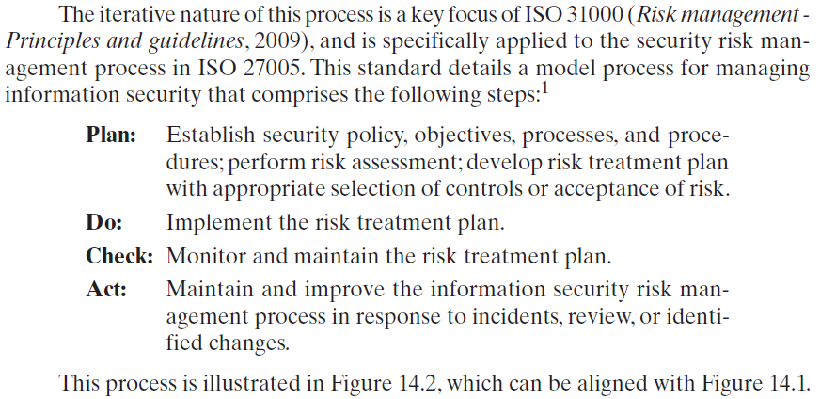
Notes:
The iterative nature of this process is a key focus of ISO 31000 (Risk management-Principles and guidelines, 2009), and is specifically applied to the security risk management process in ISO 27005.
This standard details a model process for managing information security that comprises the following steps:
Plan: Establish security policy, objectives, processes and procedures; perform risk assessment; develop risk treatment plan with appropriate selection of controls or acceptance of risk.
Do: Implement the risk treatment plan.
Check: Monitor and maintain the risk treatment plan.
Act: Maintain and improve the information security risk management in response to incidents, review, or identified changes.
This process is illustrated in Figure 14.2, which can be aligned with Figure 14.1. The outcome of this process should be that the security needs of the interested parties are managed appropriately.

Slide 7
Organizational Context and Security Policy
Maintained and updated regularly
Using periodic security reviews
Reflect changing technical/risk environments
Examine role and importance of IT systems in organization
First examine organization’s IT security:
Objectives - wanted IT security outcomes
Strategies - how to meet objectives
Policies - identify what needs to be done
Notes:
The initial step in the IT security management process comprises an examination of
the organization’s IT security objectives, strategies, and policies in the context of the
organization’s general risk profile. This can only occur in the context of the wider
organizational objectives and policies, as part of the management of the organization.
Organizational security objectives identify what IT security outcomes should be
achieved. They need to address individual rights, legal requirements, and standards
imposed on the organization, in support of the overall organizational objectives.
Organizational security strategies identify how these objectives can be met. Organizational
security policies identify what needs to be done. These objectives, strategies, and
policies need to be maintained and regularly updated based on the results of periodic
security reviews to reflect the constantly changing technological and risk environments.
To help identify these organizational security objectives, the role and importance
of the IT systems in the organization is examined. The value of these systems
in assisting the organization achieve its goals is reviewed, not just the direct costs of
these systems. Questions that help clarify these issues include the following:
• What key aspects of the organization require IT support in order to function
efficiently?
• What tasks can only be performed with IT support?
• Which essential decisions depend on the accuracy, currency, integrity, or
availability of data managed by the IT systems?
• What data created, managed, processed, and stored by the IT systems need
protection?
• What are the consequences to the organization of a security failure in their IT
systems?
If the answers to some of the above questions show that IT systems are important
to the organization in achieving its goals, then clearly the risks to them should be
assessed and appropriate action taken to address any deficiencies identified. A list
of key organization security objectives should result from this examination.
Once the objectives are listed, some broad strategy statements can be developed.
These outline in general terms how the identified objectives will be met in a consistent
manner across the organization. The topics and details in the strategy statements
depend on the identified objectives, the size of the organization, and the importance
of the IT systems to the organization. The strategy statements should address the
approaches the organization will use to manage the security of its IT systems.

Slide 8
Security Policy
Needs to address:
Scope and purpose including relation of objectives to business, legal, regulatory requirements
IT security requirements
Assignment of responsibilities
Risk management approach
Security awareness and training
General personnel issues and any legal sanctions
Integration of security into systems development
Information classification scheme
Contingency and business continuity planning
Incident detection and handling processes
How and when policy reviewed, and change control to it
Notes:
Given the organizational security objectives and strategies, an organizational
security policy is developed that describes what the objectives and strategies are and
the process used to achieve them. The organizational or corporate security policy
may be either a single large document or, more commonly, a set of related documents.
This policy typically needs to address at least the following topics:
• The scope and purpose of the policy
• The relationship of the security objectives to the organization’s legal and
regulatory obligations, and its business objectives
• IT security requirements in terms of confidentiality, integrity, availability,
accountability, authenticity, and reliability, particularly with regard to the
views of the asset owners
• The assignment of responsibilities relating to the management of IT security
and the organizational infrastructure
• The risk management approach adopted by the organization
• How security awareness and training is to be handled
• General personnel issues, especially for those in positions of trust
• Any legal sanctions that may be imposed on staff, and the conditions under
which such penalties apply
• Integration of security into systems development and procurement
• Definition of the information classification scheme used across the organization
• Contingency and business continuity planning
• Incident detection and handling processes
• How and when this policy should be reviewed
• The method for controlling changes to this policy
The intent of the policy is to provide a clear overview of how an organization’s IT
infrastructure supports its overall business objectives in general, and more specifically
what security requirements must be provided in order to do this most
effectively.

Slide 9
Management Support
IT security policy must be supported by senior management
Need IT security officer
To provide consistent overall supervision
Liaison with senior management
Maintenance of IT security objectives, strategies, policies
Handle incidents
Management of IT security awareness and training programs
Interaction with IT project security officers
Large organizations need separate IT project security officers associated with major projects and systems
Manage security policies within their area
Notes:
It is critical that an organization’s IT security policy has full approval and buy-in
by senior management. Without this, experience shows that it is unlikely that sufficient
resources or emphasis will be given to meeting the identified objectives and achieving
a suitable security outcome. With the clear, visible support of senior management, it is
much more likely that security will be taken seriously by all levels of personnel in the
organization. This support is also evidence of concern and due diligence in the management
of the organization’s systems and the monitoring of its risk profile.
Because the responsibility for IT security is shared across the organization,
there is a risk of inconsistent implementation of security and a loss of central
monitoring and control. The various standards strongly recommend that overall
responsibility for the organization’s IT security be assigned to a single person, the
organizational IT security officer. This person should ideally have a background in
IT security. The responsibilities of this person include:
• Oversight of the IT security management process
• Liaison with senior management on IT security issues
• Maintenance of the organization’s IT security objectives, strategies, and policies
• Coordination of the response to any IT security incidents
• Management of the organization-wide IT security awareness and training
programs
• Interaction with IT project security officers
Larger organizations will need separate IT project security officers associated with
major projects and systems. Their role is to develop and maintain security policies
for their systems, develop and implement security plans relating to these systems,
handle the day-to-day monitoring of the implementation of these plans, and assist
with the investigation of incidents involving their systems.

Slide 10
Security Risk Assessment
Critical component of process
Ideally examine every organizational asset
Not feasible in practice
Approaches to identifying and mitigating risks to an organization’s IT infrastructure:
Informal
Detailed risk
Combined
Baseline
Notes:
We now turn to the key risk management component of the IT security process.
This stage is critical, because without it there is a significant chance that resources
will not be deployed where most effective. The result will be that some risks are
not addressed, leaving the organization vulnerable, while other safeguards may be
deployed without sufficient justification, wasting time and money. Ideally every
single organizational asset is examined, and every conceivable risk to it is evaluated.
If a risk is judged to be too great, then appropriate remedial controls are deployed to
reduce the risk to an acceptable level. In practice this is clearly impossible. The time
and effort required, even for large, well-resourced organizations, is clearly neither
achievable nor cost effective. Even if possible, the rapid rate of change in both IT
technologies and the wider threat environment means that any such assessment
would be obsolete as soon as it is completed, if not earlier! Clearly some form of
compromise evaluation is needed.
Another issue is the decision as to what constitutes an appropriate level of
risk to accept. In an ideal world the goal would be to eliminate all risks completely.
Again, this is simply not possible. A more realistic alternative is to expend an amount
of resources in reducing risks proportional to the potential costs to the organization
should that risk occur. This process also must take into consideration the likelihood
of the risk’s occurrence. Specifying the acceptable level of risk is simply prudent
management and means that resources expended are reasonable in the context of
the organization’s available budget, time, and personnel resources. The aim of the
risk assessment process is to provide management with the information necessary for
them to make reasonable decisions on where available resources will be deployed.
Given the wide range of organizations, from very small businesses to global
multinationals and national governments, there clearly needs to be a range of alternatives
available in performing this process. There are a range of formal standards that
detail suitable IT security risk assessment processes, including ISO 13335, ISO 27005,
ISO 31000, and NIST SP 800-30. In particular, ISO 13335 recognizes four approaches
to identifying and mitigating risks to an organization’s IT infrastructure:
• Baseline approach
• Informal approach
• Detailed risk analysis
• Combined approach
The choice among these will be determined by the resources available to the organization
and from an initial high-level risk analysis that considers how valuable the IT systems
are and how critical to the organization’s business objectives. Legal and regulatory
constraints may also require specific approaches. This information should be determined
when developing the organization’s IT security objectives, strategies, and policies.

Slide 11
Baseline Approach
Goal is to implement agreed controls to provide protection against the most common threats
Forms a good base for further security measures
Use “industry best practice”
Easy, cheap, can be replicated
Gives no special consideration to variations in risk exposure
May give too much or too little security
Generally recommended only for small organizations without the resources to implement more structured approaches
Notes:
The baseline approach to risk assessment aims to implement a basic general level
of security controls on systems using baseline documents, codes of practice, and
industry best practice . The advantages of this approach are that it doesn’t require
the expenditure of additional resources in conducting a more formal risk assessment
and that the same measures can be replicated over a range of systems. The
major disadvantage is that no special consideration is given to variations in the organization’s
risk exposure based on who they are and how their systems are used.
Also, there is a chance that the baseline level may be set either too high, leading to
expensive or restrictive security measures that may not be warranted, or set too low,
resulting in insufficient security and leaving the organization vulnerable.
The goal of the baseline approach is to implement generally agreed controls to
provide protection against the most common threats. These would include implementing
industry best practice in configuring and deploying systems, like those we discuss in
Chapter 12 on operating systems security. As such, the baseline approach forms a good
base from which further security measures can be determined. Suitable baseline recommendations
and checklists may be obtained from a range of organizations, including:
• Various national and international standards organizations
• Security-related organizations such as the CERT, NSA, and so on
• Industry sector councils or peak groups
The use of the baseline approach alone would generally be recommended only for
small organizations without the resources to implement more structured approaches.
But it will at least ensure that a basic level of security is deployed, which is not
guaranteed by the default configurations of many systems.

Slide 12
Informal Approach
Involves conducting an informal, pragmatic risk analysis on organization’s IT systems
Exploits knowledge and expertise of analyst
Fairly quick and cheap
Judgments can be made about vulnerabilities and risks that baseline approach would not address
Some risks may be incorrectly assessed
Skewed by analyst’s views, varies over time
Suitable for small to medium sized organizations where IT systems are not necessarily essential
Notes:
The informal approach involves conducting some form of informal, pragmatic risk
analysis for the organization’s IT systems. This analysis does not involve the use of
a formal, structured process, but rather exploits the knowledge and expertise of the
individuals performing this analysis. These may either be internal experts, if available,
or, alternatively, external consultants. A major advantage of this approach is
that the individuals performing the analysis require no additional skills. Hence, an
informal risk assessment can be performed relatively quickly and cheaply. In addition,
because the organization’s systems are being examined, judgments can be
made about specific vulnerabilities and risks to systems for the organization that
the baseline approach would not address. Thus more accurate and targeted controls
may be used than would be the case with the baseline approach. There are a number
of disadvantages. Because a formal process is not used, there is a chance that some
risks may not be considered appropriately, potentially leaving the organization vulnerable.
Besides, because the approach is informal, the results may be skewed by the
views and prejudices of the individuals performing the analysis. It may also result in
insufficient justification for suggested controls, leading to questions over whether
the proposed expenditure is really justified. Lastly, there may be inconsistent results
over time as a result of differing expertise in those conducting the analysis.
The use of the informal approach would generally be recommended for small
to medium-sized organizations where the IT systems are not necessarily essential to
meeting the organization’s business objectives and where additional expenditure on
risk analysis cannot be justified.

Slide 13
Detailed Risk Analysis
Most comprehensive approach
Assess using formal structured process
Number of stages
Identify threats and vulnerabilities to assets
Identify likelihood of risk occurring and consequences
Significant cost in time, resources, expertise
May be a legal requirement to use
Suitable for large organizations with IT systems critical to their business objectives
Notes:
The third and most comprehensive approach is to conduct a detailed risk assessment
of the organization’s IT systems, using a formal structured process. This provides
the greatest degree of assurance that all significant risks are identified and their
implications considered. This process involves a number of stages, including
identification of assets, identification of threats and vulnerabilities to those assets,
determination of the likelihood of the risk occurring and the consequences to the
organization should that occur, and hence the risk the organization is exposed to. With
that information, appropriate controls can be chosen and implemented to address
the risks identified. The advantages of this approach are that it provides the most
detailed examination of the security risks of an organization’s IT system, and produces
strong justification for expenditure on the controls proposed. It also provides
the best information for continuing to manage the security of these systems as they
evolve and change. The major disadvantage is the significant cost in time, resources,
and expertise needed to perform such an analysis. The time taken to perform this
analysis may also result in delays in providing suitable levels of protection for some
systems. The details of this approach are discussed in the next section.
The use of a formal, detailed risk analysis is often a legal requirement for
some government organizations and businesses providing key services to them. This
may also be the case for organizations providing key national infrastructure. For
such organizations, there is no choice but to use this approach. It may also be the
approach of choice for large organizations with IT systems critical to their business
objectives and with the resources available to perform this type of analysis.

Slide 14
Combined Approach
Combines elements of the baseline, informal, and detailed risk analysis approaches
Aim is to provide reasonable levels of protection as quickly as possible then to examine and adjust the protection controls deployed on key systems over time
Approach starts with the implementation of suitable baseline security recommendations on all systems
Next, systems either exposed to high risk levels or critical to the organization's business objectives are identified in the high-level risk assessment
A decision can then be made to possibly conduct an immediate informal risk assessment on key systems, with the aim of relatively quickly tailoring controls to more accurately reflect their requirements
Lastly, an ordered process of performing detailed risk analyses of these systems can be instituted
Over time, this can result in the most appropriate and cost-effective security controls being selected and implemented on these systems
Notes:
The last approach combines elements of the baseline, informal, and detailed risk
analysis approaches. The aim is to provide reasonable levels of protection as quickly
as possible, and then to examine and adjust the protection controls deployed on key
systems over time. The approach starts with the implementation of suitable baseline
security recommendations on all systems. Next, systems either exposed to high risk
levels or critical to the organization’s business objectives are identified in the high-level
risk assessment. A decision can then be made to possibly conduct an immediate
informal risk assessment on key systems, with the aim of relatively quickly
tailoring controls to more accurately reflect their requirements. Lastly, an ordered
process of performing detailed risk analyses of these systems can be instituted. Over
time this can result in the most appropriate and cost-effective security controls being
selected and implemented on these systems. This approach has a significant number
of advantages. The use of the initial high-level analysis to determine where further
resources need to be expended, rather than facing a full detailed risk analysis of
all systems, may well be easier to sell to management. It also results in the development
of a strategic picture of the IT resources and where major risks are likely
to occur. This provides a key planning aid in the subsequent management of the
organization’s security. The use of the baseline and informal analyses ensures that a
basic level of security protection is implemented early. And it means that resources
are likely to be applied where most needed and that systems most at risk are likely
to be examined further reasonably early in the process. However, there are some
disadvantages. If the initial high-level analysis is inaccurate, then some systems for
which a detailed risk analysis should be performed may remain vulnerable for some
time. Nonetheless, the use of the baseline approach should ensure a basic minimum
security level on such systems. Further, if the results of the high-level analysis are
reviewed appropriately, the chance of lingering vulnerability is minimized.
ISO13335 considers that for most organizations, in most circumstances, this
approach is the most cost effective. Consequently its use is highly recommended.

Slide 15
Detailed Security Risk Analysis
Provides the most accurate evaluation of an organization's IT system’s security risks
Highest cost
Initially focused on addressing defense security concerns
Often mandated by government organizations and associated businesses
Notes:
The formal, detailed security risk analysis approach provides the most accurate
evaluation of an organization’s IT system’s security risks, but at the highest cost.
This approach has evolved with the development of trusted computer systems,
initially focused on addressing defense security concerns, as we discuss in Chapter 13 .
The original security risk assessment methodology was given in the Yellow Book
standard (CSC-STD-004-85 June 1985), one of the original U.S. TCSEC rainbow
book series of standards. Its focus was entirely on protecting the confidentiality of
information, reflecting the military concern with information classification. The
recommended rating it gave for a trusted computer system depended on difference
between the minimum user clearance and the maximum information classification.
Specifically it defined a risk index as
Risk Index = Max Info Sensitivity - Min User Clearance
A table in this standard, listing suitable categories of systems for each risk level,
was used to select the system type. Clearly this limited approach neither adequately
reflects the range of security services required nor the wide range of possible threats.
Over the years since, the process of conducting a security risk assessment that does
consider these issues has evolved.

Slide 16
Chapter 19
Legal and Ethical Aspects
Notes:
The legal and ethical aspects of computer security encompass a broad range of
topics, and a full discussion is well beyond the scope of this book. In this chapter, we
touch on a few important topics in this area.
The bulk of this book examines technical approaches to the detection, prevention,
and recovery from computer and network attacks. Chapters 16 and 17 examine
physical and human-factor approaches, respectively, to strengthening computer
security. All of these measures can significantly enhance computer security but
cannot guarantee complete success in detection and prevention. One other tool is
the deterrent factor of law enforcement. Many types of computer attacks can be
considered crimes and, as such, carry criminal sanctions. This section begins with a
classification of types of computer crime and then looks at some of the unique law
enforcement challenges of dealing with computer crime.

Slide 17
“Computer crime, or cybercrime, is a term used broadly to describe criminal activity in which computers or computer networks are a tool, a target, or a place of criminal activity.”
--From the New York Law School Course on
Cybercrime, Cyberterrorism, and Digital
Law Enforcement
Notes:
Computer crime, or cybercrime, is a term used broadly to describe criminal activity
in which computers or computer networks are a tool, a target, or a place of criminal
activity. These categories are not exclusive, and many activities can be characterized
as falling in one or more categories. The term cybercrime has a connotation of
the use of networks specifically, whereas computer crime may or may not involve
networks.

Slide 18
Types of Computer Crime
The U.S. Department of Justice categorizes computer crime based on the role that the computer plays in the criminal activity:
Computers as targets
Involves an attack on data integrity, system integrity, data confidentiality, privacy, or availability
Computers as storage devices
Using the computer to store stolen password lists, credit card or calling card numbers, proprietary corporate information, pornographic image files, or pirated commercial software
Computers as communications tools
Crimes that are committed online, such as fraud, gambling, child pornography, and the illegal sale of prescription drugs, controlled substances, alcohol, or guns
Notes:
The U.S. Department of Justice [DOJ00] categorizes computer crime based
on the role that the computer plays in the criminal activity, as follows:
• Computers as targets: This form of crime targets a computer system, to
acquire information stored on that computer system, to control the target
system without authorization or payment (theft of service), or to alter the
integrity of data or interfere with the availability of the computer or server.
Using the terminology of Chapter 1 , this form of crime involves an attack on
data integrity, system integrity, data confidentiality, privacy, or availability.
• Computers as storage devices: Computers can be used to further unlawful
activity by using a computer or a computer device as a passive storage medium.
For example, the computer can be used to store stolen password lists, credit
card or calling card numbers, proprietary corporate information, pornographic
image files, or “warez” (pirated commercial software).
• Computers as communications tools: Many of the crimes falling within this
category are simply traditional crimes that are committed online. Examples
include the illegal sale of prescription drugs, controlled substances, alcohol,
and guns; fraud; gambling; and child pornography.

Slide 19
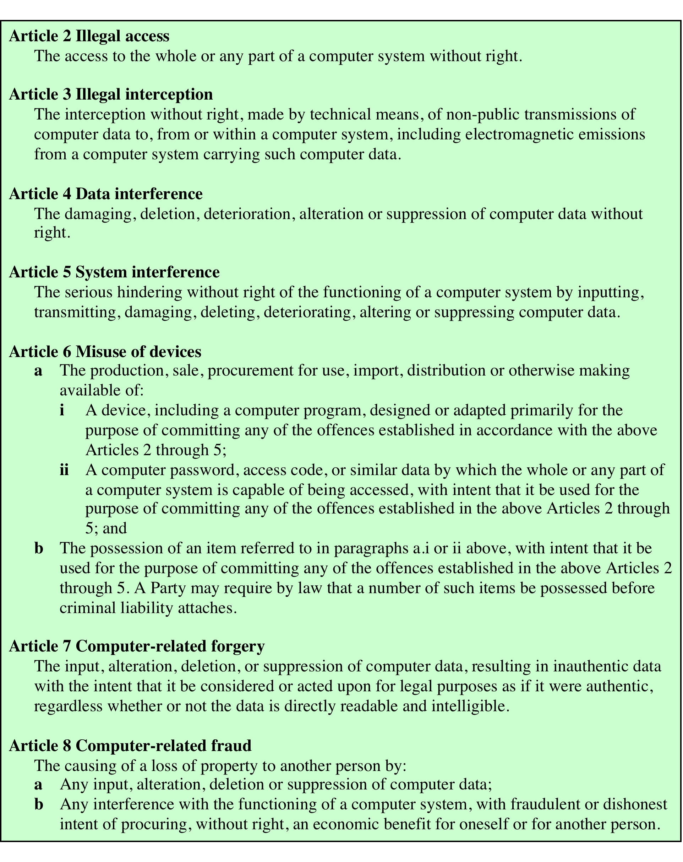
Table 19.1 Cybercrimes Cited in the Convention on Cybercrime (page 1 of 2)
Notes:
A more specific list of crimes, shown in Table 19.1 , is defined in the
international Convention on Cybercrime. This is a useful list because it represents
an international consensus on what constitutes computer crime, or cybercrime, and
what crimes are considered important.

Slide 20
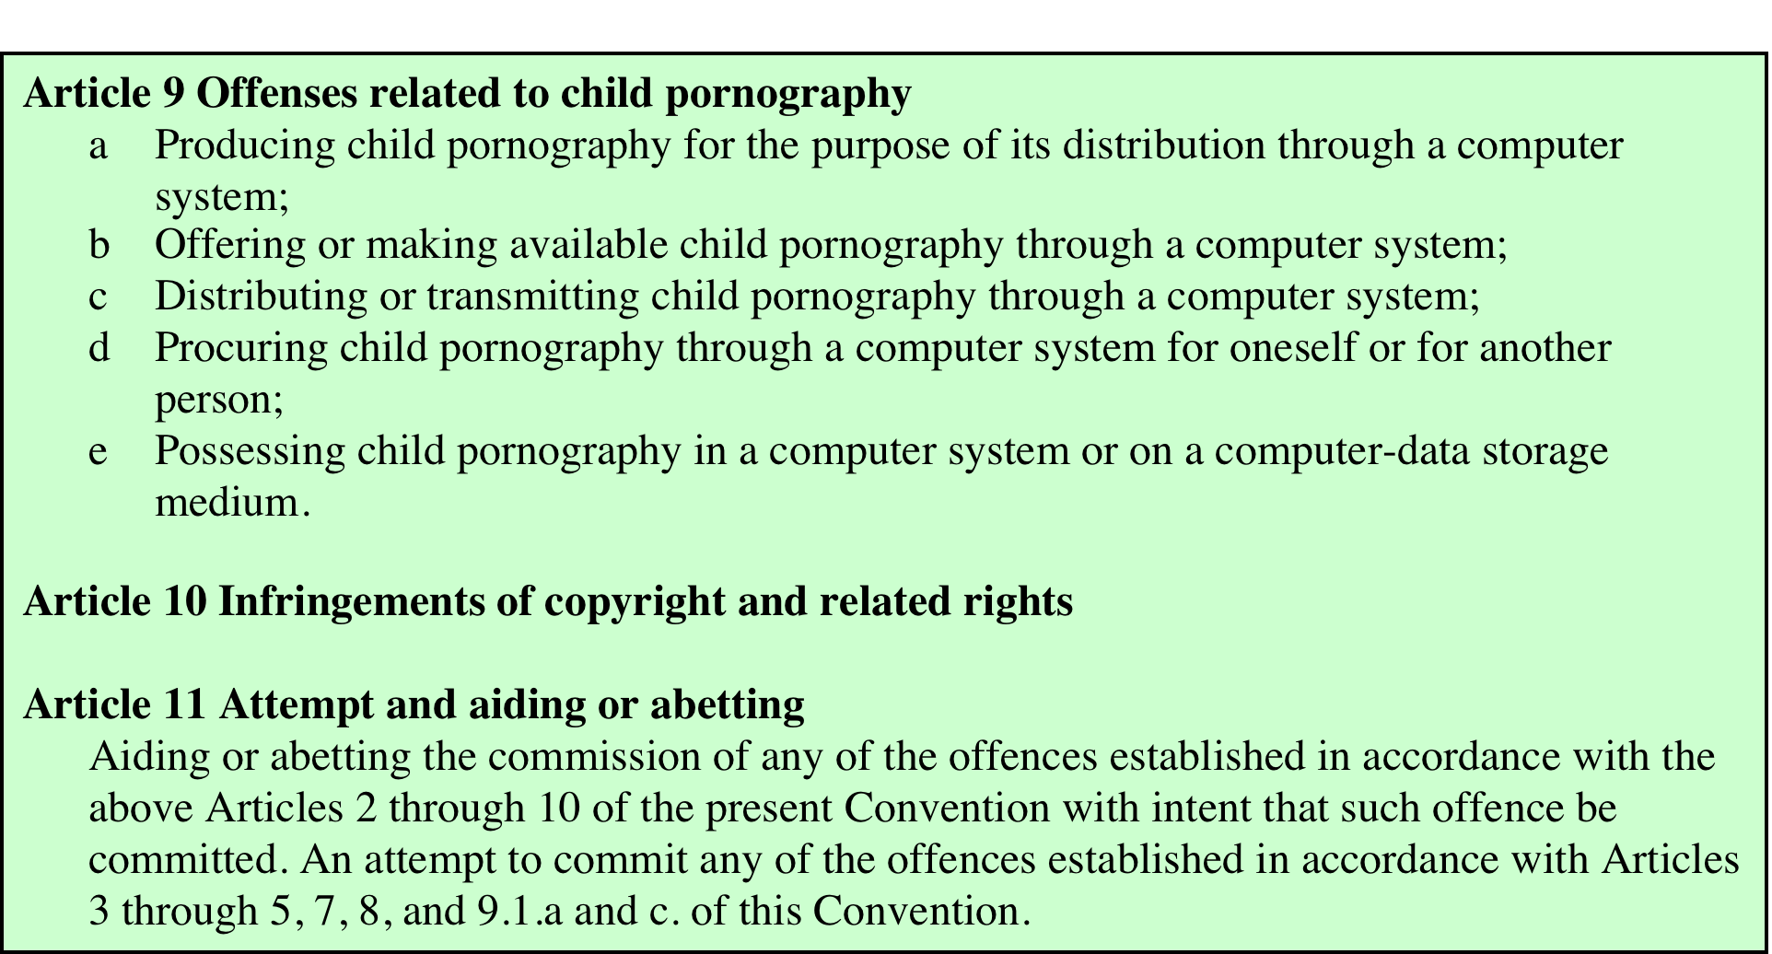
Table 19.1 Cybercrimes Cited in the Convention on Cybercrime (page 2 of 2)
Notes:
Table 19.1 Cybercrimes Cited in the Convention on Cybercrime. Page 2 of 2.

Slide 21
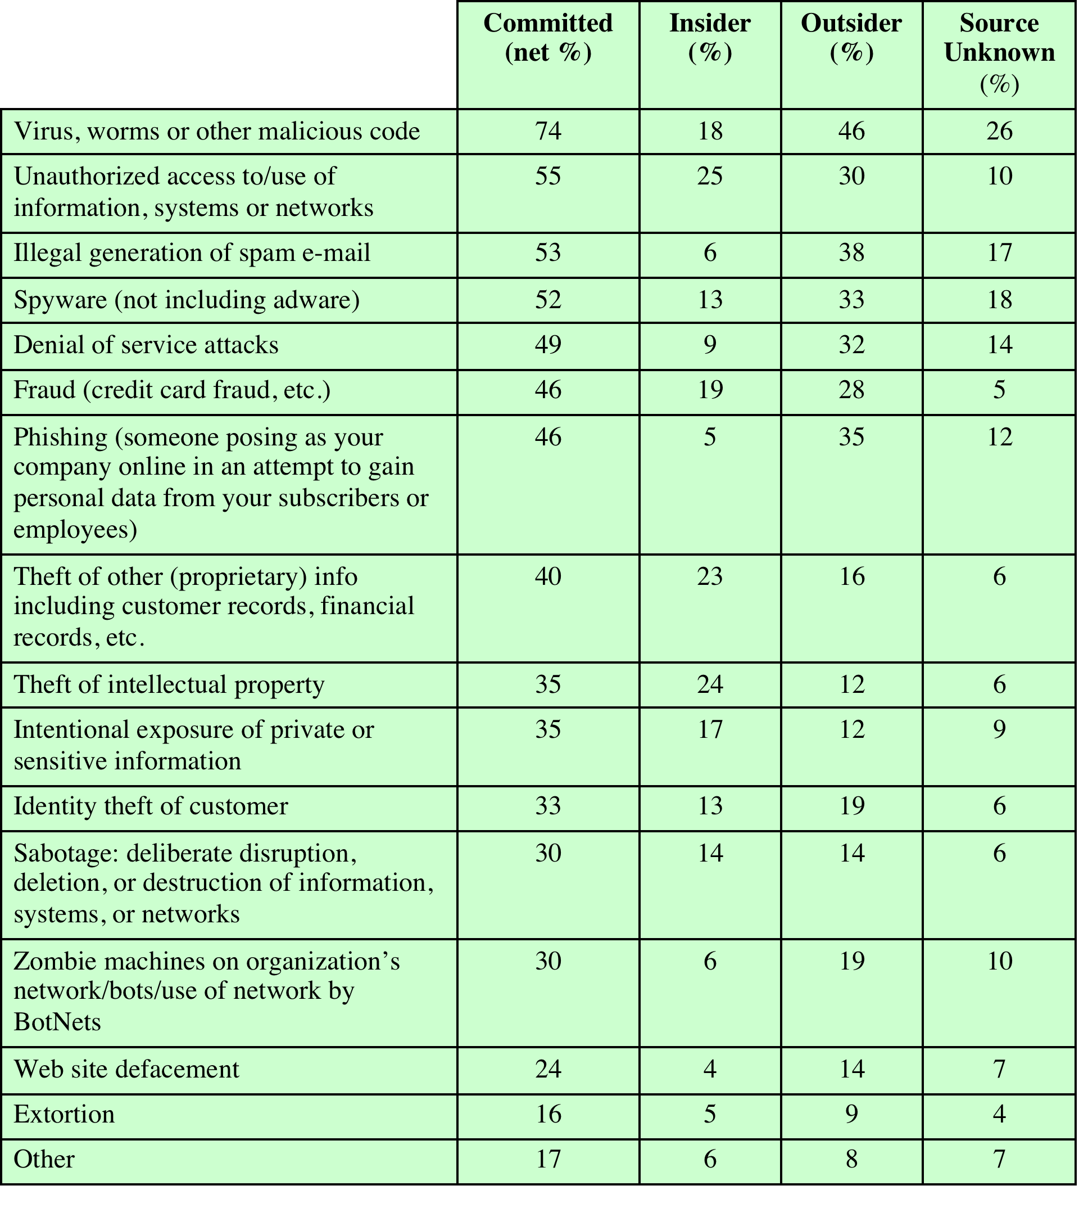
Table 19.2 CERT 2007 E-Crime Watch Survey Results
(Table can be found on page 582 in the textbook)
Notes:
Yet another categorization is used in the CERT 2007 E-crime Survey, the
results of which are shown in Table 19.2 . The figures in the second column indicate
the percentage of respondents who report at least one incident in the corresponding
row category. Entries in the remaining three columns indicate the percentage of
respondents who reported a given source for an attack.

Slide 22
Law Enforcement Challenges
The deterrent effect of law enforcement on computer and network attacks correlates with the success rate of criminal arrest and prosecution
Law enforcement agency difficulties:
Lack of investigators knowledgeable and experienced in dealing with this kind of crime
Required technology may be beyond their budget
The global nature of cybercrime
Lack of collaboration and cooperation with remote law enforcement agencies
Convention on Cybercrime introduces a common terminology for crimes and a framework for harmonizing laws globally
Notes:
The deterrent effect of law enforcement on computer and network attacks correlates
with the success rate of criminal arrest and prosecution. The nature of cybercrime
is such that consistent success is extraordinarily difficult. To see this, consider what
[KSHE06] refers to as the vicious cycle of cybercrime, involving law enforcement
agencies, cybercriminals, and cybercrime victims.
For law enforcement agencies, cybercrime presents some unique difficulties.
Proper investigation requires a fairly sophisticated grasp of the technology.
Although some agencies, particularly larger agencies, are catching up in this
area, many jurisdictions lack investigators knowledgeable and experienced in
dealing with this kind of crime. Lack of resources represents another handicap.
Some cybercrime investigations require considerable computer processing
power, communications capacity, and storage capacity, which may be beyond the
budget of individual jurisdictions. The global nature of cybercrime is an additional
obstacle: Many crimes will involve perpetrators who are remote from the target
system, in another jurisdiction or even another country. A lack of collaboration and
cooperation with remote law enforcement agencies can greatly hinder an investigation.
Initiatives such as international Convention on Cybercrime are a promising
sign. The Convention at least introduces a common terminology for crimes and a
framework for harmonizing laws globally.

Slide 23
Cybercriminals
The lack of success in bringing them to justice has led to an increase in their numbers, boldness, and the global scale of their operations
Are difficult to profile
Tend to be young and very computer-savvy
Range of behavioral characteristics is wide
No cybercriminal databases exist that can point to likely suspects
Notes:
The relative lack of success in bringing cybercriminals to justice has led to an
increase in their numbers, boldness, and the global scale of their operations. It is
difficult to profile cybercriminals in the way that is often done with other types of
repeat offenders. The cybercriminal tends to be young and very computer-savvy,
but the range of behavioral characteristics is wide. Further, there exist no cybercriminal
databases that can point investigators to likely suspects.

Slide 24
Cybercrime Victims
Are influenced by the success of cybercriminals and the lack of success of law enforcement
Many of these organizations have not invested sufficiently in technical, physical, and human-factor resources to prevent attacks
Reporting rates tend to be low because of a lack of confidence in law enforcement, concern about corporate reputation, and a concern about civil liability
Notes:
The success of cybercriminals, and the relative lack of success of law enforcement,
influence the behavior of cybercrime victims. As with law enforcement, many
organizations that may be the target of attack have not invested sufficiently in technical,
physical, and human-factor resources to prevent attacks. Reporting rates tend to
be low because of a lack of confidence in law enforcement, a concern about corporate
reputation, and a concern about civil liability. The low reporting rates and the
reluctance to work with law enforcement on the part of victims feeds into the handicaps
under which law enforcement works, completing the vicious cycle.
Executive management and security administrators need to look upon law enforcement
as another resource and tool, alongside technical, physical, and human-factor
resources. The successful use of law enforcement depends much more on people
skills than technical skills. Management needs to understand the criminal investigation
process, the inputs that investigators need, and the ways in which the victim can
contribute positively to the investigation.

Slide 25
Working with Law Enforcement
Executive management and security administrators need to look upon law enforcement as a resource and tool
Management needs to:
Understand the criminal investigation process
Understand the inputs that investigators need
Understand the ways in which the victim can contribute positively to the investigation
Notes:
Executive management and security administrators need to look upon law enforcement
as another resource and tool, alongside technical, physical, and human-factor
resources. The successful use of law enforcement depends much more on people
skills than technical skills. Management needs to understand the criminal investigation
process, the inputs that investigators need, and the ways in which the victim can
contribute positively to the investigation.

Slide 26
Pakistan is Prevention of Electronic Crimes Act, 2016 (“Act”)
The law dealing with cyber crimes in Pakistan is Prevention of Electronic Crimes Act, 2016 (“Act”) which is applicable to every citizen of Pakistan wherever he may be and to every other person who is stationed in Pakistan for the time being.

Slide 27
Types of cyber crimes under the Act:
Access or interfere the data or information system and copying or transmission of data; (Section 3, 4 and 5 of the Act).
Unauthorized access, unauthorized copying, unauthorized transmitting or unauthorized interfering with the critical infrastructure OR threaten to commit any of the aforesaid offences with an intention to coerce, intimidate, create a sense of fear, panic, insecurity or public or community/society (Sections 6, 7 and 8 of the Act).
Prepare or disseminate information through any information system or device with the intent to glorify an offence relating to terrorism, or any person convicted of a crime relating to terrorism OR threaten to commit any of the aforesaid offences with an intention to coerce, intimidate, create a sense of fear, panic, insecurity or public or community/society (Section 9 of the Act ).

Slide 28
Types of cyber crimes under the Act:
Whosoever prepares or disseminates any Hate Speech, information that invites motivation of people to fund or recruits for terrorism through any information system or device (Sections 11 & 12 of the Act).
Electronic forgery and electronic fraud committed by interfering with any information system, device or data with the intent to cause damage or injury to the public; or to make any illegal claim; or title or to cause any person to part with property; or to enter into a contract; to commit fraud; alteration, deletion or suppression of data etc. (Sections 13 & 14 of the Act).
An act to manufacture, generate, adapt, export, supply, offer to supply or import any information system, data or device, with an intent to be used or believing that it is primarily to be used to commit or to assist in the commission of an offence under this Act. (Section 15 of the Act).

Slide 29
Types of cyber crimes under the Act:
Unauthorized use of another person’s identity information or to obtain, sell, possess or transmit such information. (Sections 16 of the Act).
Issuance of SIM (subscriber identity module); R-IUM (re-useable identification module); or UICC (universal integrated circuit) or any other module designed for authenticating users to establish connection with the network and to be used in cellular mobile, wireless phone or other digital devices without obtaining and verification of the subscriber’s antecedents. (Section 17 of the Act).
Dignity of Natural Person: Public exhibit or display or transmission of any information knowingly that such information is false and intimidate or harm the reputation or privacy of a natural person through an information system. (Section 20 of the Act).

Slide 30
Types of cyber crimes under the Act:
Modesty of Natural Person:, Intentional and public display or exhibition or transmission of any information which superimposes a photograph over any sexually explicit image or video of a natural person; includes a photograph in sexually explicit conduct of a natural person; intimates a natural person with sexual act; sexually explicit image or video of a natural person; or entices or induces a natural person to engage in sexually explicit act; through an information system to harm a natural person or his reputation, take revenge, create hatred or blackmail a natural person. (Section 21 of the Act).
Child Pornography: Produce, offer or make available, distribute or transmit through an information system or to procure for himself or for any other person or without lawful justification possesses material in an information system any material which contain the elements of child pornography. (Section 22 of the Act).
Writing, offering, making available, distributing or transmitting malicious code through an information system with an intent to cause harm to any information system or data resulting in the corruption, destruction, alteration suppression, theft or loss of information system. (Section 23 of the Act).

Slide 31
Types of cyber crimes under the Act:
Doing Cyber Stalking with an intent to coerce or intimidate or harass any person by using information system, information system network, internet website, electronic mail or any similar means of communication. The term Cyber Stalking includes: (a) foster personal interaction repeatedly to a person who clearly indicates a disinterest from the stalker; (b) monitor the internet, electronic mail, text message or any other form of electronic communication of another person; (c) watch or spy upon a person in a manner that results in fear of violence or serious alarm or distress in mind of such persons; and (d) take photograph or make video of a person and display or distribute such video in a manner without his consent that harms a person. (Section 24 of the Act).
Spamming: A person commits the offence of spamming who with an intent transmits harmful, fraudulent, misleading, illegal or unsolicited information to any person without permission of the recipient or who causes any information system to show any such information for wrongful gain. (Section 25 of the Act).

Slide 32
Privacy
Overlaps with computer security
Dramatic increase in scale of information collected and stored
Motivated by law enforcement, national security, economic incentives
Individuals have become increasingly aware of access and use of personal information and private details about their lives
Concerns about extent of privacy compromise have led to a variety of legal and technical approaches to reinforcing privacy rights
Notes:
An issue with considerable overlap with computer security is that of privacy. On
one hand, the scale and interconnectedness of personal information collected and
stored in information systems has increased dramatically, motivated by law enforcement,
national security, and economic incentives. The last mentioned has been
perhaps the main driving force. In a global information economy, it is likely that the
most economically valuable electronic asset is aggregations of information on individuals
[JUDY14]. On the other hand, individuals have become increasingly aware
of the extent to which government agencies, businesses, and even Internet users have
access to their personal information and private details about their lives and activities.
Concerns about the extent to which personal privacy has been and may be
compromised have led to a variety of legal and technical approaches to reinforcing
privacy rights.

Slide 33
European Union (EU) Directive on Data Protection
Adopted in 1998 to:
Ensure member states protect fundamental privacy rights when processing personal information
Prevent member states from restricting the free flow of personal information within EU
Organized around principles of:
Notice
Consent
Consistency
Access
Security
Onward transfer
Enforcement
Notes:
A number of international organizations and national governments have introduced
laws and regulations intended to protect individual privacy. We look at two
such initiatives in this subsection.
In 1998, the EU adopted the
Directive on Data Protection to both (1) ensure that member states protected
fundamental privacy rights when processing personal information, and (2) prevent
member states from restricting the free flow of personal information within the
EU. The Directive is not itself a law, but requires member states to enact laws
encompassing its terms. The Directive is organized around the following principles
of personal information use:
• Notice: Organizations must notify individuals what personal information they
are collecting, the uses of that information, and what choices the individual
may have.
• Consent: Individuals must be able to choose whether and how their personal
information is used by, or disclosed to, third parties. They have the right
not to have any sensitive information collected or used without express
permission, including race, religion, health, union membership, beliefs, and
sex life.
• Consistency: Organizations may use personal information only in accordance
with the terms of the notice given the data subject and any choices with respect
to its use exercised by the subject.
• Access: Individuals must have the right and ability to access their information
and correct, modify, or delete any portion of it.
• Security: Organizations must provide adequate security, using technical and
other means, to protect the integrity and confidentiality of personal information.
• Onward transfer: Third parties receiving personal information must provide
the same level of privacy protection as the organization from whom the information
is obtained.
• Enforcement: The Directive grants a private right of action to data subjects
when organizations do not follow the law. In addition, each EU member has a
regulatory enforcement agency concerned with privacy rights enforcement.
More recently, the EU adopted further directives relevant to data privacy.
One is the 2002 Directive on Privacy and Electronic Communications that imposes
an obligation on member states to safeguard the confidentiality of communications
and related traffic data. Another is the 2006 Data Retention Directive that
imposes an obligation on member states to ensure that communications service
providers retain specified categories of communications data for a period of
6–24 months, and to make this data available to competent national authorities
in accordance with national law. However, this latter directive was declared invalid
by the Court of Justice of the European Union as being unjustified interference
with the privacy rights enshrined in the EU Charter [RYAN16]. This illustrates the
difficult task legislators face balancing data surveillance with appropriate levels of
privacy.

Slide 34
United States Privacy Initiatives
Privacy Act of 1974
Deals with personal information collected and used by federal agencies
Permits individuals to determine records kept
Permits individuals to forbid records being used for other purposes
Permits individuals to obtain access to records and to correct and amend records as appropriate
Ensures agencies properly collect, maintain, and use personal information
Creates a private right of action for individuals
Also have a range of other privacy laws
Notes:
The first comprehensive privacy legislation
adopted in the United States was the Privacy Act of 1974, which dealt with personal
information collected and used by federal agencies. The Act is intended to
1. Permit individuals to determine what records pertaining to them are collected,
maintained, used, or disseminated.
2. Permit individuals to forbid records obtained for one purpose to be used for
another purpose without consent.
3. Permit individuals to obtain access to records pertaining to them and to correct
and amend such records as appropriate.
4. Ensure that agencies collect, maintain, and use personal information in a manner
that ensures that the information is current, adequate, relevant, and not
excessive for its intended use.
5. Create a private right of action for individuals whose personal information is
not used in accordance with the Act.
As with all privacy laws and regulations, there are exceptions and conditions
attached to this Act, such as criminal investigations, national security concerns, and
conflicts between competing individual rights of privacy.
While the 1974 Privacy Act covers government records, a number of other
U.S. laws have been enacted that cover other areas, including the following:
• Banking and financial records: Personal banking information is protected
in certain ways by a number of laws, including the recent Financial Services
Modernization Act.
• Credit reports: The Fair Credit Reporting Act confers certain rights on individuals
and obligations on credit reporting agencies.
• Medical and health insurance records: A variety of laws have been in place
for decades dealing with medical records privacy. The Health Insurance
Portability and Accountability Act (HIPPA) created significant new rights for
patients to protect and access their own health information.
• Children’s privacy: The Children’s Online Privacy Protection Act places
restrictions on online organizations in the collection of data from children
under the age of 13.
• Electronic communications: The Electronic Communications Privacy Act
generally prohibits unauthorized and intentional interception of wire an
electronic communications during the transmission phase and unauthorized
accessing of electronically stored wire and electronic communications.

Slide 35
ISO 27002 states . . .
“An organization’s data policy for privacy and protection
of personally identifiable information should be developed
and implemented. This policy should be communicated to all
persons involved in the processing of personally identifiable information. Compliance with this policy and all relevant legislation and regulations concerning the protection of the privacy of people and the protection of personally identifiable information requires appropriate management structure and control. Often this is best achieved by the appointment of a person responsible, such as a privacy officer, who should provide guidance to managers, users and service providers on their individual responsibilities and the specific procedures that should be followed. Responsibility for handling personally identifiable information and ensuring awareness of the privacy principles should be dealt with in accordance with relevant legislation and regulations. Appropriate technical and organizational measures to protect personally identifiable information should be implemented.”
Notes:
Organizations need to deploy both management controls and technical measures
to comply with laws and regulations concerning privacy as well as to implement
corporate policies concerning employee privacy. ISO 27002 ( Code of Practice for
Information Security Management, October 2013) states the requirement as follows:
Privacy and protection of personally identifiable information An organization’s
data policy for privacy and protection of personally identifiable information
should be developed and implemented. This policy should be communicated
to all persons involved in the processing of personally identifiable information.
Compliance with this policy and all relevant legislation and regulations concerning
the protection of the privacy of people and the protection of personally identifiable
information requires appropriate management structure and control. Often
this is best achieved by the appointment of a person responsible, such as a privacy
officer, who should provide guidance to managers, users and service providers
on their individual responsibilities and the specific procedures that should be
followed. Responsibility for handling personally identifiable information and
ensuring awareness of the privacy principles should be dealt with in accordance
with relevant legislation and regulations. Appropriate technical and organizational
measures to protect personally identifiable information should be implemented.
An excellent, detailed list of considerations for organizational implementation
of privacy controls is provided in The Standard of Good Practice for Information
Security , from the Information Security Forum [ISF12]. This material is reproduced
in Appendix H4.

Slide 36
Privacy and Data Surveillance
The demands of big business, government and law enforcement have created new threats to personal privacy
Scientific and medical research data collection for analysis
Law enforcement data surveillance
Private organizations profiling
This creates tension between enabling beneficial outcomes is areas including scientific research, public health, national security, law enforcement and efficient use of resources, while still respecting an individual’s right to privacy
Another areas of particular concern is the rapid rise in the use of public social media sites
These sites gather, analyze, and share large amounts of data on individuals and their interactions with other individuals and organizations
Many people willingly upload large amounts of personal information, including photos and status updates
This data could potentially be used by current and future employers, insurance companies, private investigators, and others, in their interactions with the individual
Notes:
The demands of big business, government and law enforcement have created
new threats to personal privacy [POLO13]. Scientific research, including medical
research, can use analysis of large collections of data to extend our knowledge
and develop new tools for enhancing health and well-being. Law enforcement and
intelligence agencies have become increasingly aggressive in using data surveillance
techniques to fulfill their mission, as vividly shown by the Snowden revelations
from 2013 on [LYON15]. And private organizations are exploiting a number of
trends to increase their ability to build detailed profiles of individuals, including the
wide-spread use of Websites and social media, the increase in electronic payment
methods, near-universal use of cellular phone communications, ubiquitous computation,
sensor webs, and so on. While such data are usually collected for a specific
purpose, such as managing client interactions, organizations increasingly wish to
reuse and analyze these data for other purposes. These purposes include better
targeting of customer marketing, research, and to help inform decision-making.
The result is a tension between, on the one hand, enabling beneficial outcomes in
areas including scientific research, public health, national security, law enforcement
and efficient use of resources, that could result from big data analytics, while on the
other hand respecting an individual’s right to privacy, fairness, equality and freedom
of speech [HORO15].
Another area of particular concern is the rapid rise in the use of public social
media sites, such as Facebook, that gather, analyze, and share large amounts of
data on individuals and their interactions with other individuals and organizations.
Many people willingly upload large amount of personal information, which previously
may have been regarded as private and sensitive, in return for the benefit of
rapidly sharing it with their friends. This information could then be aggregated and
analyzed by these companies. While some work has been done on suitable regulation
of such companies and the way they manage and use such data, as [SMIT12] notes,
very little has been done on the effect of other people’s data on individuals. This
includes the upload of photos or status updates by others that include an individual,
which may also include relevant metadata such as time and location. Such data could
potentially be used by current and future employers, insurance companies, private
investigators, and others, in their interactions with the individual, possibly to that
individual’s detriment.

Slide 37
Privacy Protection
Both policy and technical approaches are needed to protect privacy
In terms of technical approaches, the requirements for privacy protection for data stored on information systems can be addresses in part using the technical mechanisms developed for database security
With regard to social media sites, technical controls include:
The provision of suitable privacy settings to manage who can view data on individuals
Notification when one individual is referenced or tagged in another’s content
Although social media sites include some form of these controls, they are constantly changing, causing frustration for users who are trying to keep up with these mechanisms
Another approach for managing privacy concerns in big data analysis is to anonymize the data, removing any personally identifying information before release to researchers or other organizations for analysis
Notes:
Both policy and technical approaches are needed to protect privacy when
both government and non-government organizations seek to learn as much as
possible about individuals. In terms of technical approaches, the requirements for
privacy protection for data stored on information systems can be addressed in part
using the technical mechanisms developed for database security, as we discussed
in Chapter 5.
With regard to social media sites, technical controls include the provision of
suitable privacy settings to manage who can view data on individuals, and notification
when one individual is referenced or tagged in another’s content. That is, by providing
suitable access controls to this data, but on a scale far larger than that used in most
IT systems. Although social media sites include some form of these controls, they
are constantly changing. This causes frustration for users, who struggle to keep up to
date with these mechanisms, and also indicates that the most appropriate controls
have yet to be found.
Another technical approach for managing privacy concerns in big data analysis
is to anonymize the data, removing any personally identifying information, before
release to researchers or other organizations for analysis. Unfortunately, a number of
recent examples have shown that such data can sometimes be reidentified, indicating
that great care is needed with this approach. Done correctly, though, it does enable
the benefits from big data analysis whilst avoiding issues of individual privacy concerns.
[HORO15] notes a recent US Federal Trade Commission framework that combines
technical and policy mechanisms which encourages this approach by protecting
against re identification of anonymized data.

Slide 38
Data Privacy
In terms of policy, guidelines are needed to manage the use and reuse of big data, ensuring suitable constraints are imposed in order to preserve privacy
Consent
Ensuring participants can make informed decisions about their participation in the research
Privacy and confidentiality
Privacy is the control that individuals have over who can access their personal information
Confidentiality is the principle that only authorized persons should have access to information
Ownership and authorship
Addresses who has responsibility for the data, and at what point does an individual give up their right to control their personal data
Data sharing – assessing the social benefits of research
The social benefits that result from data matching and reuse of data from one source or research project in another
Governance and custodianship
Oversight and implementation of the management, organization, access, and preservation of digital data
Notes:
In terms of policy, guidelines are needed to manage the use and reuse of big data,
ensuring suitable constraints are imposed in order to preserve privacy. [CLAR15]
details a set of guidelines for the use of digital data in human research, but which
could easily be applied in other areas. The guidelines address the following areas:
• Consent: Ensuring participants can make informed decisions about their
Participation in the research.
• Privacy and confidentiality: Privacy is the control that individuals have over
who can access their personal information. Confidentiality is the principle that
only authorized persons should have access to information.
• Ownership and authorship: Addresses who has responsibility for the data, and at
what point does an individual give up their right to control their personal data.
• Data sharing—assessing the social benefits of research: The social benefits that
result from data matching and reuse of data from one source or research project
in another.
• Governance and custodianship: Oversight and implementation of the management,
organization, access, and preservation of digital data.
In another policy approach, [POLO13] argues that a suitable cost-benefit analysis
by decision makers of big data systems should balance the clear privacy costs
against the benefits of the use of big data. It suggests focusing on who are the beneficiaries
of big data analysis, what is the nature of the perceived benefits, and with
what level of certainty can those benefits be realized. In doing so, it offers ways to take
account of benefits that accrue not only to businesses but also to individuals and to
society at large that result from this use.
We also see changes in laws in various countries in response to some of these
concerns. With regard to the use of mass versus targeted surveillance, [LYON15] discusses
changes in laws in several countries, including the United States and the United
Kingdom, that aim to limit bulk collection of metadata. These laws attempt to better
regulate the mass surveillance efforts of the NSA and its sister agencies, and address
the concern that metadata is regarded as personal data by many individuals, despite
arguments to the contrary by these agencies. The paper continues by exploring the
research challenges in the field of surveillance studies that could assist in further
developing the understanding of and response to these issues. [RYAN16] discusses
how recent decisions of the courts in the United Kingdom, the European Union,
and Canada address the tension between security benefits resulting from big data
analysis of metadata gathered from mobile phone and Internet usage, and personal
privacy. These responses include declaring some legislation invalid, and in other cases
imposing safeguards designed to further protect privacy rights. It notes that key issues
addressed in these cases include the areas of justification of necessary but proportional
intrusion upon privacy rights, accountability for such intrusions to independent
authorities, and transparency to the public on the types of intrusions permitted.

Slide 39
Ethical Issues
Many potential misuses and abuses of information and electronic communication that create privacy and security problems
Basic ethical principles developed by civilizations apply
Unique considerations surrounding computers and information systems
Scale of activities not possible before
Creation of new types of entities for which no agreed ethical rules have previously been formed
Ethics:
“A system of moral principles that relates to the benefits and harms of particular actions, and to the rightness and wrongness of motives and ends of those actions.”
Notes:
Because of the ubiquity and importance of information systems in organization of
all types, there are many potential misuses and abuses of information and electronic
communication that create privacy and security problems. In addition to questions
of legality, misuse and abuse raise concerns of ethics. Ethics refers to a system of
moral principles that relates to the benefits and harms of particular actions, and to
the rightness and wrongness of motives and ends of those actions. In this section,
we look at ethical issues as they relate to computer and information system security.
To a certain extent, a characterization of what constitutes ethical behavior for
those who work with or have access to information systems is not unique to this
context. The basic ethical principles developed by civilizations apply. However,
there are some unique considerations surrounding computers and information
systems. First, computer technology makes possible a scale of activities not
possible before. This includes a larger scale of recordkeeping, particularly on individuals,
with the ability to develop finer-grained personal information collection
and more precise data mining and data matching. The expanded scale of communications
and the expanded scale of interconnection brought about by the Internet
magnify the power of an individual to do harm. Second, computer technology has
involved the creation of new types of entities for which no agreed ethical rules
have previously been formed, such as databases, Web browsers, chat rooms, cookies,
and so on.

Slide 40
Notes:
Further, it has always been the case that those with special knowledge or
special skills have additional ethical obligations beyond those common to all
humanity. We can illustrate this in terms of an ethical hierarchy ( Figure 19.5 ), based
on one discussed in [GOTT99]. At the top of the hierarchy are the ethical values
professionals share with all human beings, such as integrity, fairness, and justice.
Being a professional with special training imposes additional ethical obligations
with respect to those affected by his or her work. General principles applicable to
all professionals arise at this level. Finally, each profession has associated with it
specific ethical values and obligations related to the specific knowledge of those
in the profession and the powers that they have to affect others. Most professions
embody all of these levels in a professional code of conduct, a subject discussed
subsequently.

Slide 41
Ethical Issues Related to Computers and Information Systems
Some ethical issues from computer use:
Repositories and processors of information
Producers of new forms and types of assets
Instruments of acts
Symbols of intimidation and deception
Those who understand, exploit technology, and have access permission, have power over these
Notes:
Let us turn now more specifically to the ethical issues that arise from computer
technology. Computers have become the primary repository of both personal information
and negotiable assets, such as bank records, securities records, and other
financial information. Other types of databases, both statistical and otherwise, are
assets with considerable value. These assets can only be viewed, created, and altered
by technical and automated means. Those who can understand and exploit the
technology, plus those who have obtained access permission, have power related to
those assets.
A classic paper on computers and ethics [PARK88] points out that ethical
issues arise as the result of the roles of computers, such as the following:
• Repositories and processors of information: Unauthorized use of otherwise
unused computer services or of information stored in computers raises questions
of appropriateness or fairness.
• Producers of new forms and types of assets: For example, computer programs
are entirely new types of assets, possibly not subject to the same concepts of
ownership as other assets.
• Instruments of acts: To what degree must computer services and users of computers,
data, and programs be responsible for the integrity and appropriateness
of computer output?
• Symbols of intimidation and deception: The images of computers as thinking
machines, absolute truth producers, infallible, subject to blame, and as anthropomorphic
replacements of humans who err should be carefully considered.

Slide 42
Professional/Ethical Responsibilities
Concern with balancing professional responsibilities with ethical or moral responsibilities
Types of ethical areas a computing or IT professional may face:
Ethical duty as a professional may come into conflict with loyalty to employer
“Blowing the whistle”
Expose a situation that can harm the public or a company’s customers
Potential conflict of interest
Organizations have a duty to provide alternative, less extreme opportunities for the employee
In-house ombudsperson coupled with a commitment not to penalize employees for exposing problems
Professional societies should provide a mechanism whereby society members can get advice on how to proceed
Notes:
We are concerned with balancing professional responsibilities with ethical
or moral responsibilities. We cite two areas here of the types of ethical questions
that face a computing or IT professional. The first is that IT professionals may find
themselves in situations where their ethical duty as professionals comes into conflict
with loyalty to their employer. Such a conflict may give rise for an employee
to consider “blowing the whistle,” or exposing a situation that can harm the public
or a company’s customers. For example, a software developer may know that a
product is scheduled to ship with inadequate testing to meet the employer’s deadlines.
The decision of whether to blow the whistle is one of the most difficult that
an IT professional can face. Organizations have a duty to provide alternative, less
extreme opportunities for the employee, such as an in-house ombudsperson coupled
with a commitment not to penalize employees for exposing problems in-house.
Additionally, professional societies should provide a mechanism whereby society
members can get advice on how to proceed.
Another example of an ethical question concerns a potential conflict of interest.
For example, if a consultant has a financial interest in a certain vendor, this
should be revealed to any client if that vendor’s products or services might be recommended
by the consultant.

Slide 43
Codes of Conduct
Ethics are not precise laws or sets of facts
Many areas may present ethical ambiguity
Many professional societies have adopted ethical codes of conduct which can:
1
2
Provide a measure of support
Be a means of deterrence and discipline
Enhance the profession's public image
Be a positive stimulus and instill confidence
Be educational
3
4
5
Notes:
Unlike scientific and engineering fields, ethics cannot be reduced to precise laws
or sets of facts. Although an employer or a client of a professional can expect that
the professional has an internal moral compass, many areas of conduct may present
ethical ambiguities. To provide guidance to professionals and to articulate what
employers and customers have a right to expect, a number of professional societies
have adopted ethical codes of conduct.
A professional code of conduct can serve the following functions [GOTT99]:
1. A code can serve two inspirational functions: as a positive stimulus for ethical
conduct on the part of the professional, and to instill confidence in the customer
or user of an IS product or service. However, a code that stops at just
providing inspirational language is likely to be vague and open to an abundance
of interpretations.
2. A code can be educational. It informs professionals about what should be their
commitment to undertake a certain level of quality of work and their responsibility
for the well-being of users of their product and the public, to the extent
the product may affect nonusers. The code also serves to educate managers on
their responsibility to encourage and support employee ethical behavior and
on their own ethical responsibilities.
3. A code provides a measure of support for a professional whose decision to act
ethically in a situation may create conflict with an employer or customer.
4. A code can be a means of deterrence and discipline. A professional society
can use a code as a justification for revoking membership or even a professional
license. An employee can use a code as a basis for a disciplinary action.
5. A code can enhance the profession’s public image, if it is seen to be widely
honored.

Slide 44
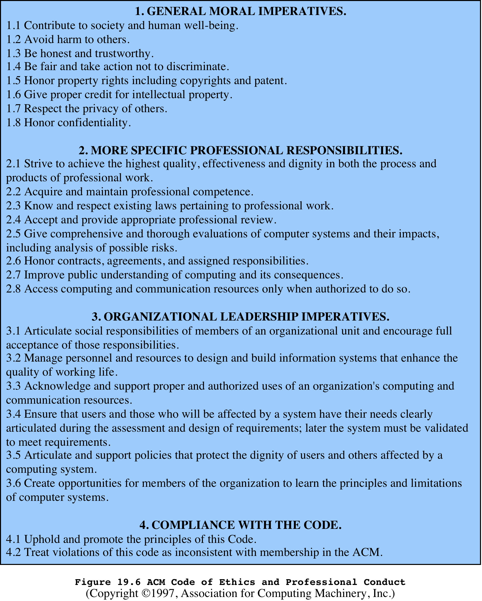
Notes:
We illustrate the concept of a professional code of ethics for computer professionals
with three specific examples. The ACM (Association for Computing
Machinery) Code of Ethics and Professional Conduct ( Figure 19.6 ) applies to
computer scientists

Slide 45
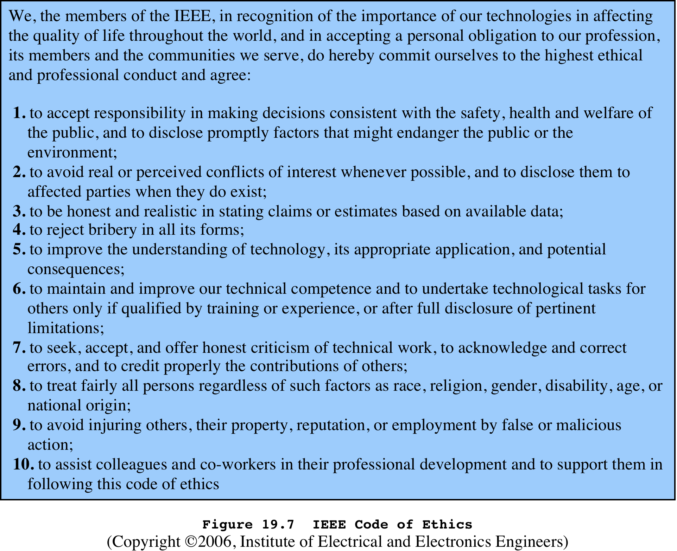
Notes:
The IEEE (Institute of Electrical and Electronic Engineers)
Code of Ethics ( Figure 19.7 ) applies to computer engineers as well as other types
of electrical and electronic engineers.

Slide 46
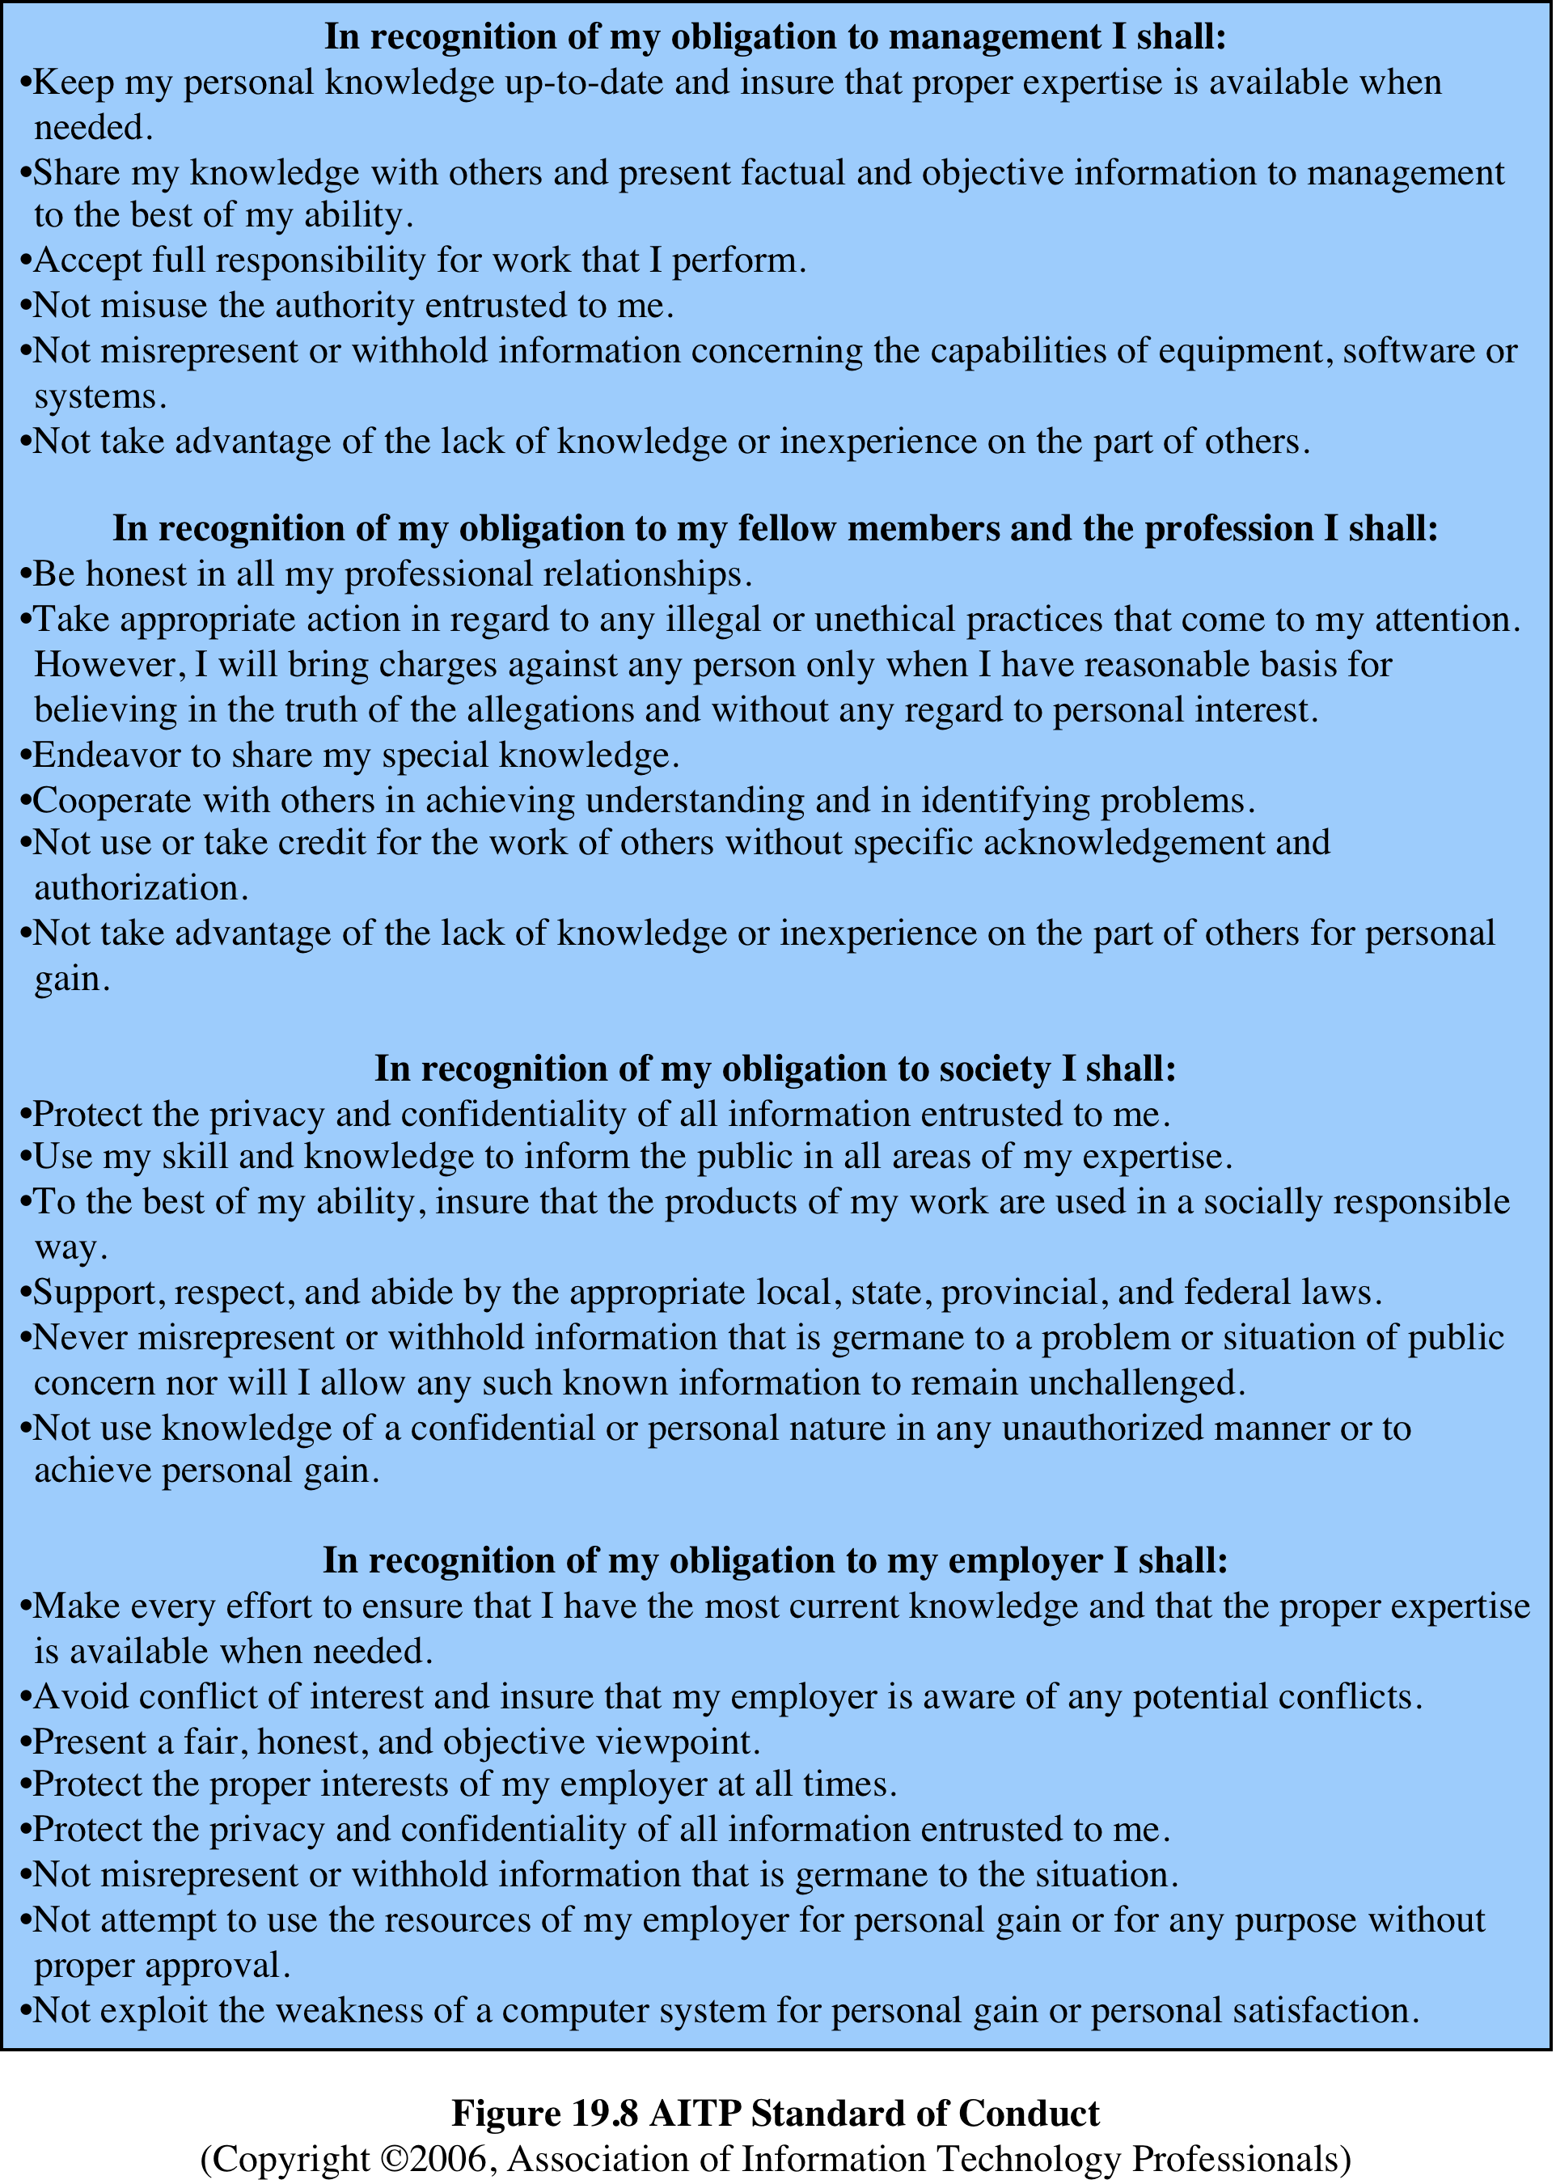
Notes:
The AITP (Association of Information
Technology Professionals, formerly the Data Processing Management
Association) Standard of Conduct ( Figure 19.8) applies to managers of computer
systems and projects.

Slide 47
Comparison of Codes of Conduct
All three codes place their emphasis on the responsibility of professionals to other people
Do not fully reflect the unique ethical problems related to the development and use of computer and IT technology
Common themes:
Dignity and worth of other people
Personal integrity and honesty
Responsibility for work
Confidentiality of information
Public safety, health, and welfare
Participation in professional societies to improve standards of the profession
The notion that public knowledge and access to technology is equivalent to social power
Notes:
A number of common themes emerge from these codes, including (1) dignity
and worth of other people; (2) personal integrity and honesty; (3) responsibility
for work; (4) confidentiality of information; (5) public safety, health, and welfare;
(6) participation in professional societies to improve standards of the profession;
and (7) the notion that public knowledge and access to technology is equivalent to
social power.
All three codes place their emphasis on the responsibility of professionals to
other people, which, after all, is the central meaning of ethics. This emphasis on
people rather than machines or software is to the good. However, the codes make
little specific mention of the subject technology, namely computers and information
systems. That is, the approach is quite generic and could apply to most professions
and does not fully reflect the unique ethical problems related to the development
and use of computer and IT technology. For example, these codes do not specifically
deal with the issues raised by [PARK88] listed in the preceding subsection.

Slide 48
The Rules
Collaborative effort to develop a short list of guidelines on the ethics of computer systems
Ad Hoc Committee on Responsible Computing
Anyone can join this committee and suggest changes to the guidelines
Moral Responsibility for Computing Artifacts
Generally referred to as The Rules
The Rules apply to software that is commercial, free, open source, recreational, an academic exercise or a research tool
Computing artifact
Any artifact that includes an executing computer program
Notes:
A different approach from the ones so far discussed is a collaborative effort to
develop a short list of guidelines on the ethics of developing computer systems. The
guidelines, which continue to evolve, are the product of the Ad Hoc Committee on
Responsible Computing. Anyone can join this committee and suggest changes to
the guidelines. The committee has publish a document, regularly updated, entitled
Moral Responsibility for Computing Artifacts , and is generally referred to as The
Rules . The current version of The Rules is version 27, reflecting the thought and
effort that has gone into this project.
The term computing artifact refers to any artifact that includes an executing
computer program. This includes software applications running on a general
purpose computer, programs burned into hardware and embedded in mechanical
devices, robots, phones, web bots, toys, programs distributed across more than one
machine, and many other configurations. The Rules apply to, among other types:
software that is commercial, free, open source, recreational, an academic exercise or
a research tool.

Slide 49
As of this writing, the rules are as follows:
The people who design, develop, or deploy a computing artifact are morally responsible for that artifact, and for the foreseeable effects of that artifact. This responsibility is shared with other people who design, develop, deploy or knowingly use the artifact as part of a sociotechnical system.
The shared responsibility of computing artifacts is not a zero-sum game. The responsibility of an individual is not reduced simply because more people become involved in designing, developing, deploying, or using the artifact. Instead, a person’s responsibility includes being answerable for the behaviors of the artifact and for the artifact’s effects after deployment, to the degree to which these effects are reasonably foreseeable by that person.
People who knowingly use a particular computing artifact are morally responsible for that use.
People who knowingly design, develop, deploy, or use a computing artifact can do so responsibly only when they make a reasonable effort to take into account the sociotechnical systems in which the artifact is embedded.
People who design, develop, deploy, promote, or evaluate a computing artifact should not explicitly or implicitly deceive users about the artifact or its foreseeable effects, or about the sociotechnical systems in which the artifact is embedded.
Notes:
As of this writing, the rules are as follows:
1. The people who design, develop, or deploy a computing artifact are morally
responsible for that artifact, and for the foreseeable effects of that artifact.
This responsibility is shared with other people who design, develop, deploy or
knowingly use the artifact as part of a sociotechnical system.
2. The shared responsibility of computing artifacts is not a zero-sum game. The
responsibility of an individual is not reduced simply because more people
become involved in designing, developing, deploying, or using the artifact.
Instead, a person’s responsibility includes being answerable for the behaviors
of the artifact and for the artifact’s effects after deployment, to the degree to
which these effects are reasonably foreseeable by that person.
3. People who knowingly use a particular computing artifact are morally responsible
for that use.
4. People who knowingly design, develop, deploy, or use a computing artifact
can do so responsibly only when they make a reasonable effort to take into
account the sociotechnical systems in which the artifact is embedded.
5. People who design, develop, deploy, promote, or evaluate a computing artifact
should not explicitly or implicitly deceive users about the artifact or its foreseeable
effects, or about the sociotechnical systems in which the artifact is embedded.
Compared to the codes of ethics discussed earlier, The Rules are few in
number and quite general in nature. They are intended to apply to a broad spectrum
of people involved in computer system design and development. The Rules have
gathered broad support as useful guidelines by academics, practitioners, computer
scientists, and philosophers from a number of countries [MILL11]. It seems likely
that The Rules will influence future versions of codes of ethics by computer-related
professional organizations.

Slide 50
Summary
Cybercrime and computer crime
Types of computer crime
Law enforcement challenges
Working with law enforcement
Intellectual property
Types of intellectual property
Intellectual property relevant to network and computer security
Digital millennium copyright act
Digital rights management
Privacy
Privacy law and regulation
Organizational response
Computer usage privacy
Privacy, data surveillance, big data, and social media
Ethical issues
Ethics and the IT professions
Ethical issues related to computers and information systems
Codes of conduct
The rules
Notes:
Chapter 19 summary.

